Slide 1
Development of master curricula for natural disasters risk management in Western Balkan countries
WP 1. Analysis of natural disasters needed to be managed in Kosovo*
dr Jelena Djokic
UPKM, TCASU
Logo of your organization
Wienna/ 04-07.04.2017
Project number: 573806-EPP-1-2016-1-RS-EPPKA2-CBHE-JP
"This project has been funded with support from the European Commission. This publication reflects the views only of the author, and the Commission cannot be held responsible for any use which may be made of the information contained therein"

Slide 2
Development of master curricula for natural disasters risk management in Western Balkan countries
Floods
Floods, heavy snowfall, drought, and other meteorological hazards
Flash floods are common in mountain areas (where average annual precipitation is as much as 1750 mm per year)
River floods occur inplains and lowlands

Slide 3
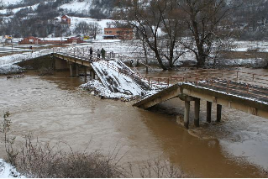
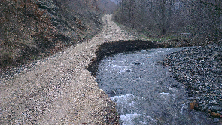
Development of master curricula for natural disasters risk management in Western Balkan countries
Floods in the Northern Kosovo Region in 2013
Agricultural facilities (incl crops and plants) | 115141€
Repair of road infrastructure | 206617 €
Repair of bridges | 132942 €
Total | 454700€

Slide 4
Extreme weather
Development of master curricula for natural disasters risk management in Western Balkan countries
January and February 2012, due to extreme low temperatures and windstorms followed by heavy snowfall, several municipalities in Kosovo have been heavily affected
Snowfall and storms caused an avalanche that resulted in ten fatalities in the village of Restelica, Dragash municipality
In 2000 moderate to severe metrological drought covered most of the territory of Kosovo, as shown in Figure 2 below.
Since 2004 80% of Kosovo municipalities have suffered from water shortages due to hydrological drought and the misuse of water resources
Since 2000 there have been an increasing number of forest fires. Fire brigades and other relevant operational teams have carried out between 2,000 and 3,000 interventions for each subsequent year.

Slide 5
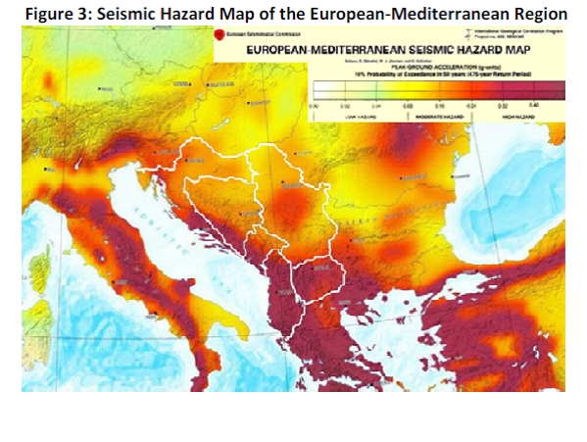
Development of master curricula for natural disasters risk management in Western Balkan countries
Earthquakes
1921 in Urosevac (intensity of IX on the MSK-64 scale and a magnitude of 6.1),
1980 in Kopaonik region (intensity of VIII degrees and a magnitude 5.9)
2002 in the Gnjilane municipality (intensity of VIII-IX and a magnitude of 5.7)
Kosovo* is located in a seismically active zone, making it susceptible to earthquakes

Slide 6
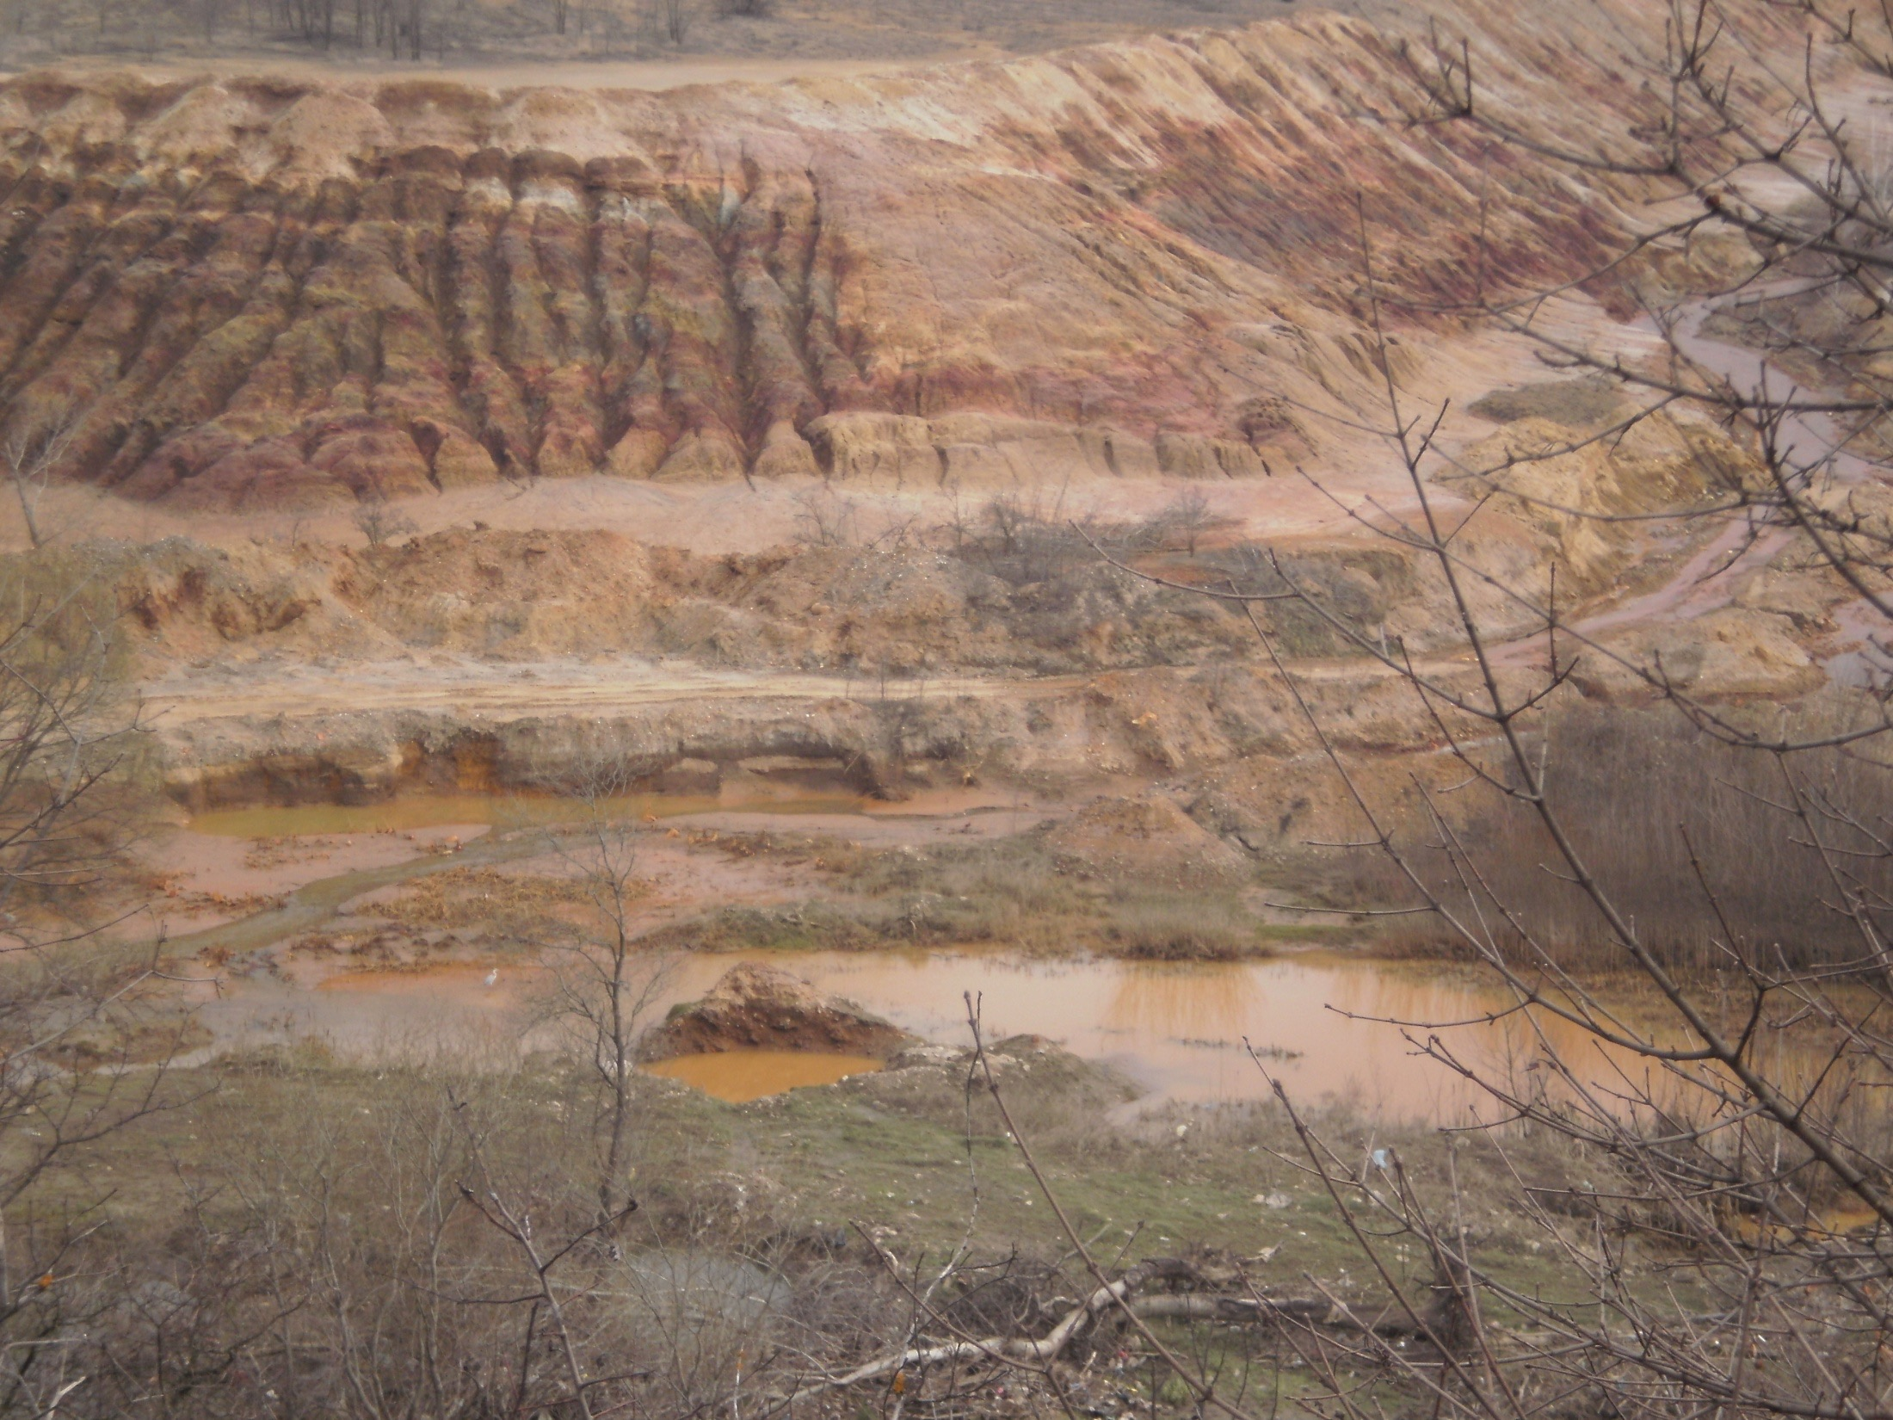
Additional risk due to the tailing waste mismanagement
 | Detektovani elementi na povrsini zemlje (mass. %)
 | O | Na | Mg | Al | Si | K | Ca | Ti | Fe | Cu | Zn | Pb
M1 | 52.76 | 1.19 | 0.85 | 6.3 | 17.55 | 1.47 | 0.86 | 0.43 | 5.77 | 2.42 | 1.84 | 8.55
M2 | 50.66 | 1.17 | 1.02 | 5.91 | 16.73 | 1.49 | 0.78 | 0.42 | 7.22 | 2.81 | 2.56 | 9.22

Slide 7
Development of master curricula for natural disasters risk management in Western Balkan countries
Established practices for risk management
civil protection system in Northern Kosovo municipalities existed on its own
without any serious development.
oriented towards response
not paid attention to disaster prevention and risk reduction.
no system in place
lack of expertise and proper financing
municipalities have never made risk assessments or disaster management plans.
Municipal authorities and emergency services respond to incidents only post factum E.g., excessive snowfalls in winter; floods in spring; drought and forest fires in summer

Slide 8
Development of master curricula for natural disasters risk management in Western Balkan countries
Duties and Responsibilities of the Municipality
-monitoring of risks, warning and alarming the population about potential threats;
- equipment with electronic communication tools for protection needs, rescue and assistance in accordance with a unique system of communication and information;
- planning and implementation of preventive measures;
- processing of risk assessment and emergency response plans;
- personal and reciprocal protection;
- organization, management and implementation of protection, rescue and assistance at the local level;
- defining, organizing and equipping units and SPRA utilities and other organizations in this field;

Slide 9
Development of master curricula for natural disasters risk management in Western Balkan countries
the supply of necessary resources for emergency accommodation in cases of natural and other disasters;
- developing and carrying out training programs of local importance;
- coordinating emergency response plans and other protection operations for rescue and assistance with neighboring municipalities;
- supplying with basic conditions of life and restoration, recovery from natural and other disasters;
- identification of organizations of special significance for protection, rescue and assistance at the local level;
- international cooperation in the protection, rescue and assistance under this law.

Slide 10
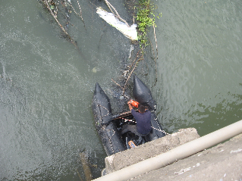
Development of master curricula for natural disasters risk management in Western Balkan countries
Specific risk management aspects
Crisis Commission chaired by the Mayor
no written procedures of the Crisis Commission work as well as coordination plans
KFOR
Fire Service
Brussels Agreement
Communication between 112 and 193

